Slide 1
Designing a Blockchain-Driven eVault System for Legal Document Preservation
CSE7301 Capstone Project
Review-0
Batch Number: CSE_ISR_CAP_08
Roll Number | Student Name
MADHUBALA S | 20211ISR0034
B KRIPASHINI | 20211ISR0045
Under the Supervision of,
Dr. Praveena K N
Assistant Professor- Senior Scale
School of Computer Science and Engineering
Presidency University
Name of the Program: B.TECH. INFORMATION SCIENCE &ENGINEERING (AI AND ROBOTICS)
Name of the HoD: Dr. Zafar Ali Khan
Name of the Program Project Coordinator: Dr.Afroz Pasha
Name of the School Project Coordinators: Dr. Sampath A K / Dr. Abdul Khadar A / Mr. Md Ziaur Rahman

Slide 2
Content
Problem Statement
Github Link
Analysis of Problem Statement
Timeline of the Project
References

Slide 3
Problem Statement Number:
Organization: Presidency University
Category (Hardware / Software / Both) : Software
Problem Description: This project, "Developing Blockchain-Based eVault for Legal Records," aims to create a decentralized and tamper-proof digital vault using blockchain technology. By leveraging the immutable nature of blockchain, this system ensures that legal documents remain secure, transparent, and resistant to any form of manipulation. The proposed system will incorporate smart contracts to automate document verification and access control, reducing the dependency on intermediaries and streamlining legal processes.
Difficulty Level: Simple

Slide 4
Github Link
The Github link provided should have public access permission.
Github Link
https://github.com/madhubala-suresh/Blockchain-Evault/upload/main

Slide 5
Analysis of Problem statement
Technology used :
Cryptographic Security – Public and private key encryption ensures secure authentication and access control, preventing unauthorized modifications.
Consensus Mechanism – Proof-of-Work (PoW), Proof-of-Stake (PoS), or Practical Byzantine Fault Tolerance (PBFT) is used for validating transactions in the blockchain network.
Web Development – React.js is used for building the front-end user interface, while Node.js and Express.js handle the backend operations.
Database Management – NoSQL databases like MongoDB are used for off-chain metadata storage, improving performance and query efficiency.
API Integration – RESTful APIs facilitate communication between the blockchain network and web applications, ensuring seamless interaction for users.
Blockchain Framework – Ethereum or Hyperledger Fabric is used to create an immutable, decentralized ledger for storing legal records securely.
Smart Contracts – Developed using Solidity (for Ethereum) or Chaincode (for Hyperledger) to automate access control, document verification, and transactions.

Slide 6
Analysis of Problem Statement (contd...)
Software Requirements:
Blockchain Development : Ethereum (for public blockchain) or Hyperledger Fabric (for private blockchain)
Backend Development : Node.js, Python
Frontend Development : React.js
Security & Cryptography : AES (Advanced Encryption Standard) for data security
Development & Testing Tools : Visual Studio Code (VS Code), Sublime Text
Hosting & Deployment : AWS, Google Cloud, or Microsoft Azure for hosting web applications
Hardware Requirements:
Processor: Intel Core i5/i7 (or AMD Ryzen 5/7)
RAM: Minimum 8GB (Recommended 16GB for better performance)
Storage: SSD with at least 256GB (Recommended 512GB for faster processing)
Graphics Card: Integrated GPU (Dedicated GPU optional for enhanced processing)

Slide 7
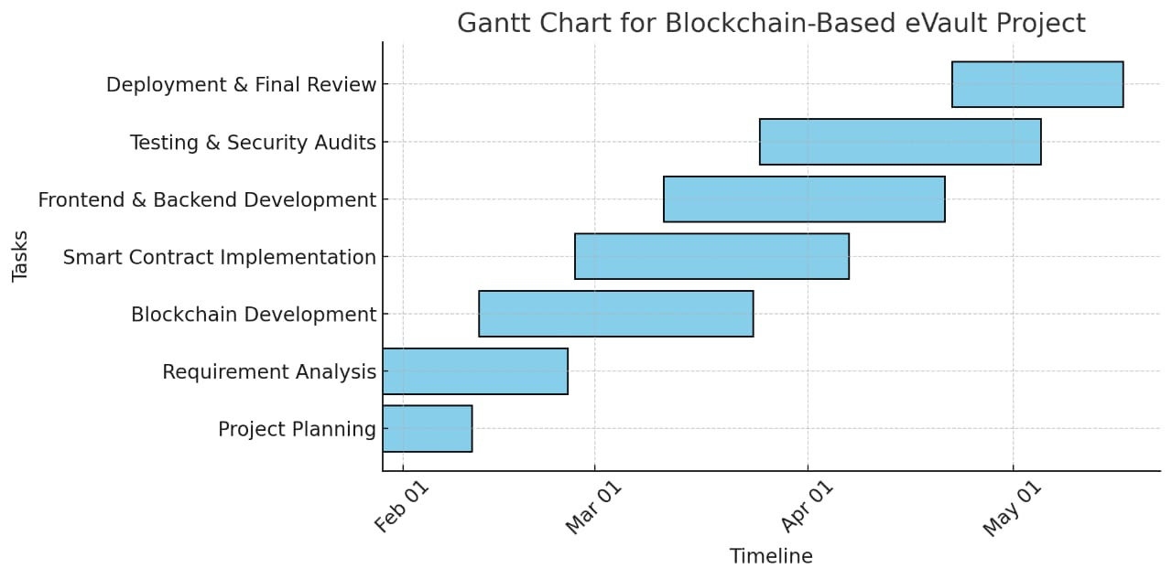
Timeline of the Project (Gantt Chart)

Slide 8
References (IEEE Paper format)
https://ieeexplore.ieee.org/document/10574924?utm_source=chatgpt.com
https://ieeexplore.ieee.org/document/9544655?utm_source=chatgpt.com
https://ieeexplore.ieee.org/document/10200234?utm_source=chatgpt.com

Slide 9


